Slide 1
Configuration Management 2
SE489: DevOps Engineering

Slide 2
Outline
Why Configuration Management
What is Configuration Management
What is Puppet?
Puppet Components and Architecture
Puppet Case Study

Slide 3
Why Configuration Management

Slide 4


Problems before Configuration Management
Configuring Large Infrastructure was a very hectic job

Slide 5

Problems before Configuration Management
Rollback to the previous stable version of the software was very difficult
Older version of the software stack
X
Updated version of the software
There are certain glitches with the updated software

Slide 6



Problems before Configuration Management
An application works in developer’s machine but not in testing and production. In Dev, there can be an upgraded software but old version in the Prod
Code works on my machine
There is some problem with the code
Dev
Prod

Slide 7
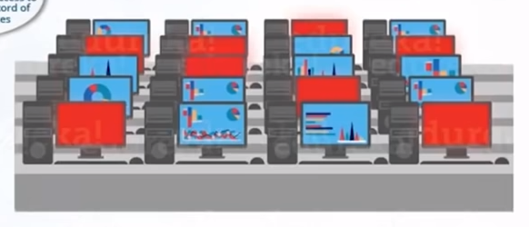
Configuration Management at NYSE
Time to rollback to the previous version of the software. Thanks to Configuration Management, we have access to accurate historical record of the software states
The 8 red marked icons are the trading terminals that are not working because of a software glitch
As a result of proper Configuration Management process, NYSE recovered from the situation in 90 minutes (very fast).
What about more time!!

Slide 8
What is Configuration Management

Slide 9
What is Configuration Management?
Configuration Management is the practice of handling changes systematically so that a system maintains its integrity over time. It allows access to an accurate historical records od system states
Dev
Infrastructure as a code (IaC)
Code for the Infrastructure
Test
Provisioning of Dev, Test, Prod environment by writing code in a centralized location
Prod

Slide 10
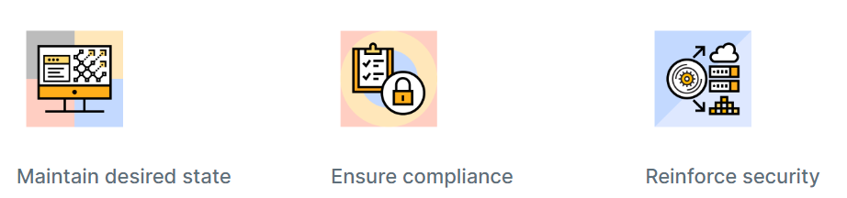
What is Configuration Management?
Configuration management is a process that helps organizations configure, maintain, correct, and ensure that computer systems and hardware remain in a desired state — without needing to track every change manually.

Slide 11
Why is configuration management important?
It is essential because it creates a consistent and predictable development environment.
It ensures that infrastructure development and deployment control processes
follow required compliance frameworks
enforce consistency and stability throughout on-premise and cloud-native environments
and reinforce security through application of self-healing infrastructure as code.

Slide 12
Why is configuration management important?
Configuration management ensures that misconfigurations don’t go unnoticed and prevents them from creating problems across the environment.
It enables automation that supports continuous compliance.
It empowers IT teams to
determine the ideal configuration across the environment
prevents unauthorized changes
catches deviations
and corrects the system back to desired state

Slide 13
Configuration Management Components
There are two type of Configuration Management approaches

Slide 14

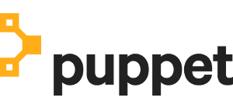
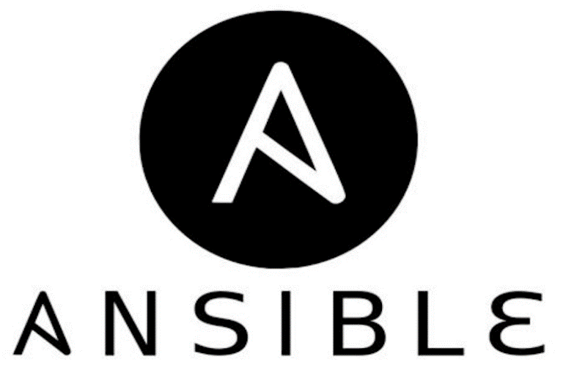

Configuration Management Tools
Pull
Push

Slide 15
What is Puppet?

Slide 16
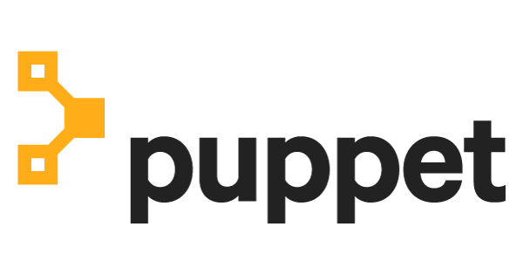
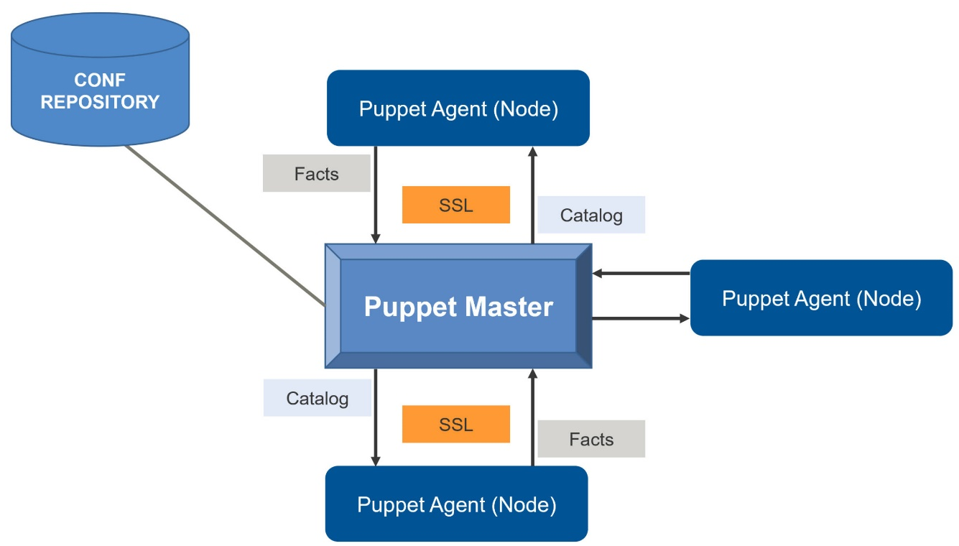
What is Puppet?
Puppet is a configuration Management tool used for:
Deploying,
Configuring and
Managing servers
It uses a Master-slave architecture

Slide 17
What is Puppet?
For centralizing and automating the configuration management process.
Widely used for server configuration, management, deployment, and orchestration of various applications and services across the whole infrastructure of an organization.
It is written in Ruby and uses its unique Domain Specific Language (DSL) to describe system configuration.

Slide 18
What is Puppet?
It performs the following functions:
Defining distinct configurations for each and every host, and continuously checking and confirming whether the required configuration is in place and is not altered
Dynamic scaling-up and scaling-down of machines
Providing automatic control over all your configured machines

Slide 19
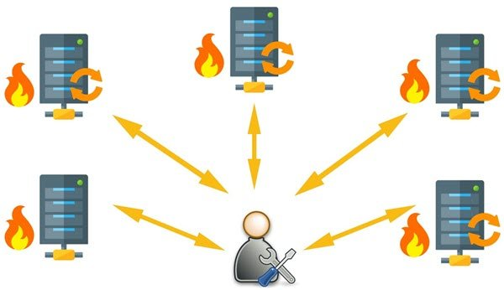
What Puppet can do?
For example, you have an infrastructure with about 100 servers. As a system admin, it’s your role to ensure that all these servers are always up to date and running with full functionality.
System Admin working manually on the servers

Slide 20
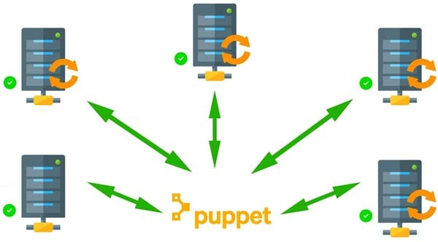
What Puppet can do?
To do this, you can use Puppet, which allows you to write a simple code which can be deployed automatically on these servers. This reduces the human effort and makes the development process fast and effective.
Puppet automates Server Management

Slide 21
Comparing Chef and Puppet
 | Puppet | Chef
Company | Developed by Puppet Labs | Opscode
Friendliness | It is more system friendly | It is more program friendly
API integration | There is no extended API | It has an extended API
Community | Wide user base | The relatively small user base
Supported platforms | A wide range of operating systems supports this tool. This feature was enhanced in 0.22.x – 0.25.x puppet versions. Puppet is also supported in Linux and Windows. | Relatively small Oss support this tool
Configuring the configuration server | Relatively Difficult | Relatively easy

Slide 22
Why should use Puppet?
Consistency
Troubleshooting problems is a time-consuming and tedious process that is to be done manually. Without configuration-management, it gets more complex to assume the infrastructure, like what version of the software is installed and the software installation process if followed on the node.
Automation
When it comes to managing 10s, 100s or more servers at a larger scale with mixed environment configuration and scaling of the infrastructure, it gets complex while ensuring the process to be efficient and secure.
IaC
Puppet treats infrastructure as code & implements all practices done by the software developer such as version control system(VCS), automated testing & continuous delivery.
Idempotency
Its ability to apply the code repeatedly and get a guaranteed desired state with the assurance of the same results.
Agile
It's based on the principle of using the agile process of working incrementally & reusability of code.

Slide 23
What are the Benefits of Puppet?
Puppet can benefit you in your infrastructure configuration & management for your glance:
Infrastructure as code(IaC)
It enables you to define infrastructure as code (IaC) with ease of coding
Disaster Recovery
Downtime due to misconfiguration issues can be reduced significantly
Speed Development
It allows a significant time saving
Constant Output
Works on an extensive infrastructure by automating repetitive tasks
It supports a vast variety of Mac OS, Microsoft Windows, Debian & many more. The best part is, it uses easy-to-learn language to define the configurations

Slide 24
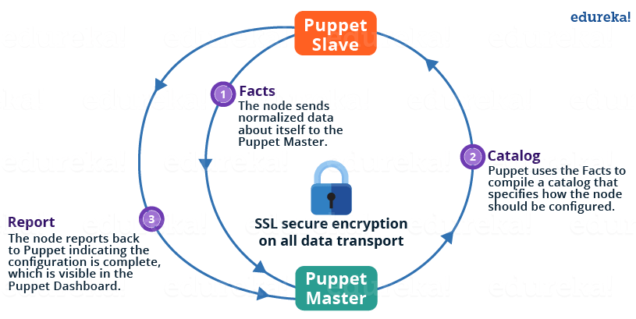
Puppet Master-Slave Architecture

Slide 25
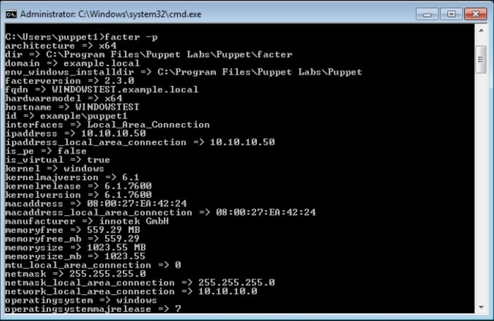
Puppet Master-Slave Architecture
Facts
Core facts: Built-in facts that ship with Facter.
Custom facts: Require Ruby code within your Puppet module to produce a value.
External facts: Generated by either pre-defined static data on the node or the result of running an executable script or program.
Facts are structured data about the system that we can use anywhere in our manifests.

Slide 26
Puppet Master-Slave Architecture
Catalog
# puppet apply mymodule/tests/init.pp –noop
Notice: Compiled catalog for puppet.example.com in environment production in 0.56 seconds
Notice: /Stage[main]/Mymodule::Httpd/Package[httpd]/ensure: current_value absent, should be present (noop)
Notice: /Stage[main]/Mymodule::Httpd/Service[httpd]/ensure: current_value stopped, should be running (noop)
Notice: Class[Mymodule::Httpd]: Would have triggered 'refresh' from 2 events
Notice: Stage[main]: Would have triggered 'refresh' from 1 events
Notice: Finished catalog run in 0.41 seconds
It is a compiled version of configuration which needs to be pushed onto target machines.
A catalog is a document that describes the desired state for each resource that Puppet manages on a node.
A primary server typically compiles a catalog from manifests of Puppet code.

Slide 27
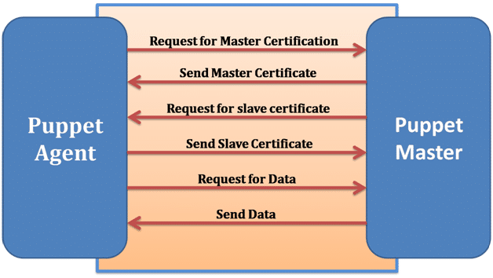
Puppet Master Slave Connection
SSL (Secure Sockets Layer) connection between Master and Slave

Slide 28
Key Puppet Concepts
Modules
To differentiate the differences between various platforms Puppet modules are used.
A good module should therefore give an API so that the software can be used on various platforms without having to know the details of the platform.
One of the main advantages of reusable modules is that other people can easily understand them.
Classes
A collection of resources that are grouped together to get a target machine or machine in the desired state.
They have defined inside Puppet manifest files which are found in Puppet modules.
Manifests
Manifests are those programs written in Ruby and saved with the .pp extension.
All Puppet programs are manifests that are built with the idea of creating and managing any target host machine.

Slide 29
Puppet Case Study (MySQL and PHP)
Using predefined modules, download modules for PHP and MySQL
Declare these two classes in the Puppet manifests
Puppet agents will pull these configurations and both will be installed in Agents
Puppet Agent
Puppet Master
Code for PHP and MySQL
Puppet Agent
Puppet Agent
Pull the Master for changes and them pull the configurations

Slide 30
Puppet Case Study Phases
Classes and Resources
Manifests
Modules

Slide 31
Resources, Classes, Manifests & Modules
Manifests can be deployed but it is a good practice to bundle all the Manifests in the form of a Module
Resource
Resource
Resource
Manifest
Module
Class
Manifest
Manifest

Slide 32
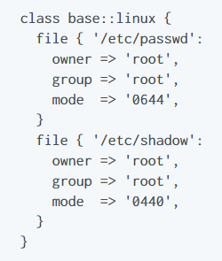

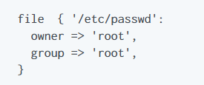
Puppet Resources and Classes
Resources are the fundamental unit for modeling system configurations. Each Resource describes some aspect of a system, like a specific service or package
Group of resources can be organized into classes, which are large units of configuration. While a resource may describe a single file or package

Slide 33
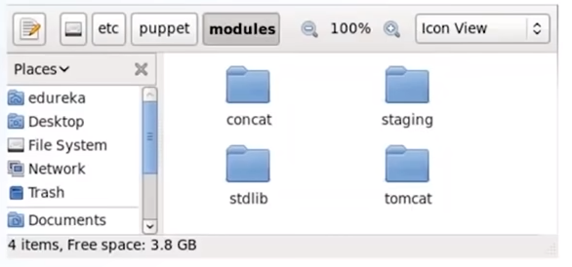
Puppet Modules
A module is a collection of manifests and data (such as facts, files, templates), and they have specific directory structure. Modules are useful for organizing Puppet code
To add a module to Puppet, place it in the etc/puppet/modules directory

Slide 34
Companies Adopting Puppet
Your interest in understanding what is Puppet would grow if you know about the companies that have adopted it to manage their infrastructure. Some of them include:
Spotify
Google
AT&T
Staples
AON
The U.S. Air Force
The reasons why these companies adopted Puppet may vary. For example, Staples used Puppet as a configuration management tool to automate its private cloud management and IT operations to provide consistency, allowing their IT teams more time to innovate.

Slide 35

Puppet Case Study
The European Organization for Nuclear Research, known as CERN, is a European research organization that operates the largest particle physics laboratory in the world.
Established in 1954, the organization is based in a northwest suburb of Geneva on the Franco-Swiss border and has 23 member states.

Slide 36
Puppet Case Study
Challenges
CERN needed a way to monitor daily operations and identify problems in real-time.
This increased the efficiency of the team and improved their planning for future infrastructure.
Solution
CERN uses a monitoring system for infrastructure that combines Puppet agents, Puppet servers, and PuppetDB in workflows collecting data in two source pipelines using data processing pipelines (Kafka, Logstash), analytics software (Elasticsearch), data storage (InfluxDB, HDFS), and frontend components (Grafana, Kibana, and Jupyter).

Slide 37
Puppet Case Study
Results
Readable data for configuration management of 40,000 nodes
Usable code extracted and documented from 350 catalogs per minute
Reduced latency
Top outcomes of using Puppet Enterprise
Improved performance
Optimized system services
Updated infrastructure health reports
Engineer time redirected to future growth

